Slide 1
Agenda
Blobs
StorSimple
Files
Tables
Queues
Notes:
Files Extra slides

Slide 2

Azure Files - SMB 2.1 Protocol
Enables moving on-premises applications that rely on shared file storage to Azure
Azure VMs can “net use” to a share
Natively supported by OS APIs, libraries, and tools
Windows (CreateFile, ReadFile, WriteFile, …)
CRTs (fopen, fread, fwrite, …)
.Net (FileStream.Read, FileStream.Write, …)
Many more
Supports standard file system semantics
Move and rename files and directories
Read-only, write through, overlapped
Change notifications

Slide 3
Azure Files - File REST APIs
Allows internet access to the same shared file system
Build hybrid applications (on premises + cloud)
Supports a variety of common APIs:
Create/Delete Files and Directories
Write/Read Files
Get File and Directory properties
List Files

Slide 4
Demo: Azure Files – Part 1

Slide 5
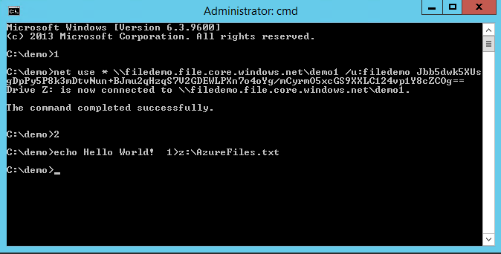
Azure Files

Slide 6
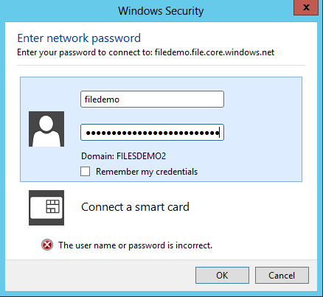
Azure Files

Slide 7
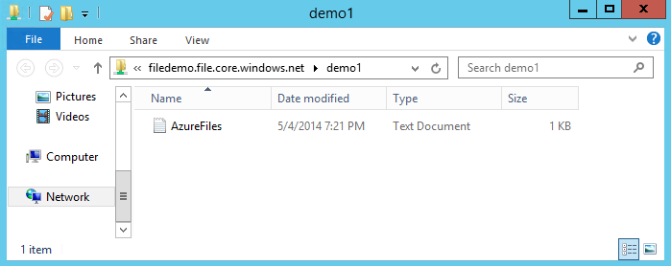
Azure Files

Slide 8
Azure Files vs Blobs
Description | Azure Blobs | Azure Files
Durability Options | LRS, ZRS, GRS (and RA-GRS for higher availability) | LRS, GRS
Accessibility | REST APIs | SMB 2.1 (standard file system APIs) REST APIs
Connectivity | REST – Worldwide | SMB 2.1 - Within region REST – Worldwide
Endpoints | http://myaccount.blob.core.windows.net/mycontainer/myblob | \\myaccount.file.core.windows.net\myshare\myfile.txt http://myaccount.file.core.windows.net/myshare/myfile.txt
Directories | Flat namespace however prefix listing can simulate virtual directories | True directory objects
Case Sensitivity of Names | Case sensitive | Case insensitive, but case preserving
Capacity | Up to 500TB containers | 5TB file shares
Throughput | Up to 60 MB/s per blob | Up to 60 MB/s per share
Object size | Up to 1 TB/blob | Up to 1 TB/file
Billed capacity | Based on bytes written | Based on file size

Slide 9
Azure Files vs Disks
Description | Disk | Azure Files
Relationship with Azure VMs | Required for booting (OS Disk)
Scope | Exclusive/Isolated to a single VM | Shared access across multiple VMs
Snapshots and Copy | Yes | No
Configuration | Configured via portal/Management APIs and available at boot time | Connect after boot (via net use on windows)
Built-in authentication | Built-in authentication | Set up authentication on net use
Cleanup | Resources can be cleaned up with VM if needed | Manually via standard file APIs or REST APIs
Access via REST | Can only access as fixed formatted VHD (single blob) via REST. Files stored in VHD cannot be accessed via REST. | Individual files stored in share are accessible via REST
Max Size | 1TB Disk | 5TB File Share 1TB file within share
Max 8KB IOps | 500 IOps | 1000 IOps
Throughput | Up to 60 MB/s per Disk | Up to 60 MB/s per File Share

Slide 10
Azure Files – Client OS Support
Windows Supported:
Windows Server 2008 R2
Windows Server 2012
Windows Server 2012 R2
Investigating Linux Support:
Ubuntu 13.10
Ubuntu 14.04 LTS

Slide 11
Demo: Azure Files – Part 2

Slide 12

Website Served From Azure File Share
…
Load Balancer
Azure VM
Azure VM
SMB 2.1
Azure File Share
REST APIs

Slide 13
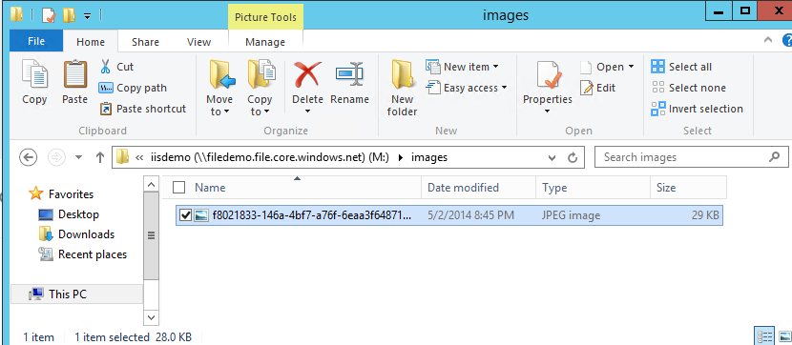
Azure Files

Slide 14
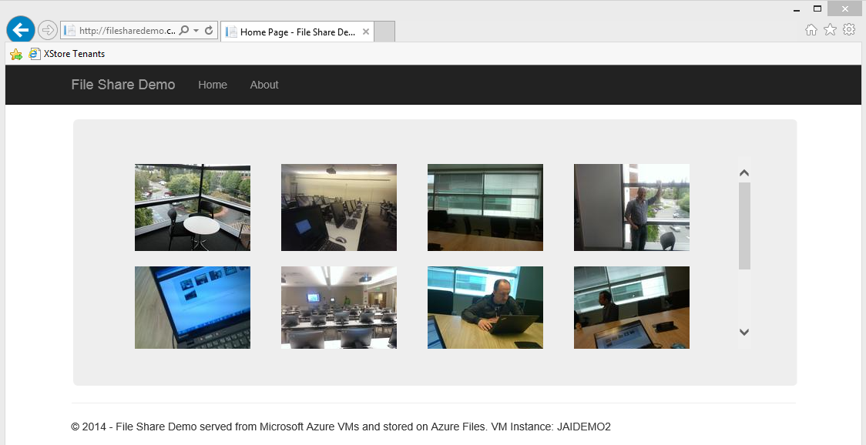
Azure Files

Slide 15
No Fixed Schema
 | FIRST | LAST | BIRTHDATE
 | Wade | Wegner | 2/2/1981
 | Nathan | Totten | 3/15/1965
 | Nick | Harris | May 1, 1976
FAV SPORT
Canoeing
Notes:
Slide Objectives
Understand Flexible Entities
Speaker Notes
Tables store data as entities.
A table can contain entities of any shape
There is no fixed schema
There is no schema checking
There is no strong typing- not that Birthdate is stored as both a datetime value and as a string
Not that we can add additional columns
Notes
http://msdn.microsoft.com/en-us/library/dd573356.aspx

Slide 16
Querying
?$filter=Last eq ‘Wegner’
 | FIRST | LAST | BIRTHDATE
 | Wade | Wegner | 2/2/1981
 | Nathan | Totten | 3/15/1965
 | Nick | Harris | May 1, 1976
Notes:
Slide Objectives
Understand The Basic Query Syntax
Speaker Notes
Tables store data as entities.
Querying is per the ADO.NET Data Services spec http://msdn.microsoft.com/en-us/library/cc668784.aspx
Should endeavour to always include the Partition key to limit scope of query- partitions always served by a single storage node
Notes
http://msdn.microsoft.com/en-us/library/dd573356.aspx

Slide 17
Partitions and Partition Ranges
PartitionKey (Category) | RowKey (Title) | Timestamp | MODELYEAR
Bikes | Super Duper Cycle | … | 2009
Bikes | Quick Cycle 200 Deluxe | … | 2007
… | … | … | …
Canoes | Whitewater | … | 2009
Canoes | Flatwater | … | 2006
PartitionKey (Category) | RowKey (Title) | Timestamp | MODELYEAR
Bikes | Super Duper Cycle | … | 2009
Bikes | Quick Cycle 200 Deluxe | … | 2007
… | … | … | …
Canoes | Whitewater | … | 2009
Canoes | Flatwater | … | 2006
Rafts | 14ft Super Tourer | … | 1999
… | … | … | …
Skis | Fabrikam Back Trackers | … | 2009
… | … | … | …
Tents | Super Palace | … | 2008
Server A
Table = Products
[MinKey - Canoes)
Server A
Table = Products
PartitionKey (Category) | RowKey (Title) | Timestamp | MODELYEAR
Rafts | 14ft Super Tourer | … | 1999
… | … | … | …
Skis | Fabrikam Back Trackers | … | 2009
… | … | … | …
Tents | Super Palace | … | 2008
Server B
Table = Products
[Canoes - MaxKey)
Notes:
Slide Objectives
Understand Partition Ranges
Speaker Notes
DON’T use unique PartionKey values for your entities – each entity will then belong to its own partition
Range partitions group entities that have sequentially, unique PartitionKey values to improve the performance of range queries.
Without range partitions, a range query will need to cross partition boundaries or server boundaries, which can decrease the performance of the query.
Notes

Slide 18
16 regions worldwide in 2014
Azure footprint

Slide 19
>57%
Greater than
1,000,000
>250k
Fortune 500 using Azure
Active websites
SQL Databases in Azure
>20
>1
TRILLION storage objects
>300
MILLION
AD users
MILLION
Developers registered with Visual Studio Online
>2
MILLION requests/sec
>13
BILLION
authentication/wk

Slide 20


Slide 21

Get started
Visit azure.microsoft.com

